Slide 1
Chapter 1 Introduction

Slide 2
Outline
A BRIEF HISTORY
PROTOCOLS AND STANDARDS
STANDARDS ORGANIZATIONS
INTERNET STANDARDS
INTERNET ADMINISTRATION

Slide 3
1.1
A
BRIEF
HISTORY
The McGraw-Hill Companies, Inc., 2000

Slide 4
Internet
Network
A group of connected, communicating devices, such as computers and printers
internet
Two or more network that can communicate with each other
Internet
The most notable internet
A collaboration of more than hundreds of thousands interconnected networks

Slide 5
Time Line
The following is a list of important Internet events in chronological order:
1969. Four-node ARPANET established
UCLA, UCSB, Stanford Research Institute, and University of Utah
1972. Birth of the Internet by introducing gateways
Connect different networks that have diverse packet size, interface and transmission rate
1973. Development of TCP/IP suite begins.
1977. An internet, consisting of ARPANET, packet radio, and packet satellite, tested using TCP/IP

Slide 6
Time Line (Cont.)
1981. UC Berkeley modified the UNIX to include TCP/IP.
1981. CSNET established
A network sponsored by NSF
1983. TCP/IP becomes the official protocol.
1983. MILNET was born since ARPANET split into
MILNET: military users, ARPANET: otherwise

Slide 7
Time Line (Cont.)
1986. NSFNET established
A backbone (T1 line) that connected five supercomputer centers
1990. ARPANET was replaced by NSFNET
1991, ANSNET established
A new, high-speed backbone
1995. NSFNET became a research network
1995. ISPs started

Slide 8
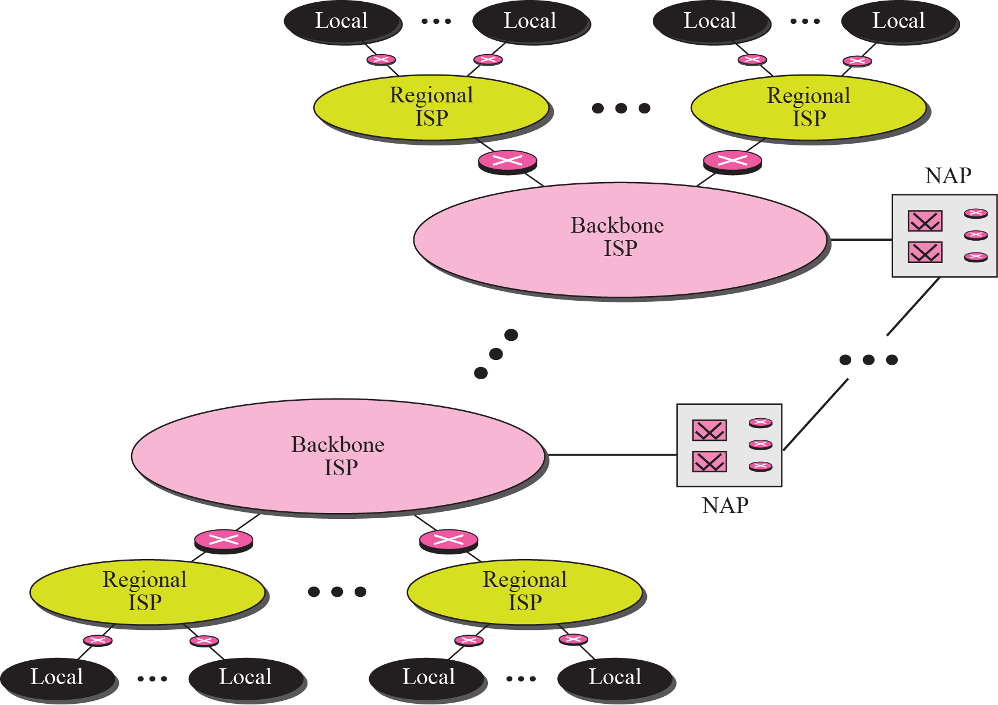
Figure 1-1
Internet Today
The McGraw-Hill Companies, Inc., 2000

Slide 9
1.2
PROTOCOLS
AND
STANDARDS
The McGraw-Hill Companies, Inc., 2000

Slide 10
Protocols
Protocol
A set of rules that governs data communications
Three key elements
Syntax
Structure and format of the data (i.e, packets)
Semantics
The meaning of each section of bits
Timing
When data should be sent
How fast it can be sent

Slide 11
Standards
Standards
Maintain an open market for manufactures
Guarantee interoperability of data communication
Two categories
De facto: by fact
Have not been approved but have been adopted through widespread use
De jure: by law
Legislated by an officially body

Slide 12
1.3
STANDARDS
ORGANIZATIONS
The McGraw-Hill Companies, Inc., 2000

Slide 13
Standard Organizations
Standard Organizations
Standard creation committees
Forums
Government regulatory agencies

Slide 14
Standards Creation Committees
International Standards Organization (ISO)
International Telecommunications Union–
Telecommunication Standards Sector (ITU-T)
American National Standards Institute (ANSI)
Institute of Electrical and Electronics Engineers (IEEE)
Electronic Industries Association (EIA)
Word Wide Web Consortium (W3C)
Open Mobile Alliance (OMA)
The McGraw-Hill Companies, Inc., 2000

Slide 15
Forums
Frame Relay Forum
ATM Forum
Universal Plug and Play (UPnP) Forum
Regulatory Agencies
Federal Communications Commission (FCC) in United States
The McGraw-Hill Companies, Inc., 2000

Slide 16
1.4
INTERNET
STANDARDS
The McGraw-Hill Companies, Inc., 2000

Slide 17
Internet Standard
Internet Standard
A thoroughly tested specification that is useful to and adhered to by those work with the Internets

Slide 18
Internet Standard (Cont.)
A specification must go through a strict procedures to attain Internet standard status
First, a specification begins as an Internet draft
Then, a draft may be published as a Request for Comment (RFC)
After that, RFC go through maturity levels and are categorized according to there requirement level

Slide 19
Maturity Level
Proposed standard
The specification is tested and implemented
Draft standard
Proposed standard is elevated to draft standard after at least two successful independent and interoperable implementations
Internet standard
Demonstrations of successful implementation

Slide 20
Maturity Level (Cont.)
Historic
Superseded by later specification or failed to become an Internet standard
Experimental
Informational
Contain general, historical, or tutorial information related to the Internet
Usually written by non-Internet organization, such as vendor

Slide 21
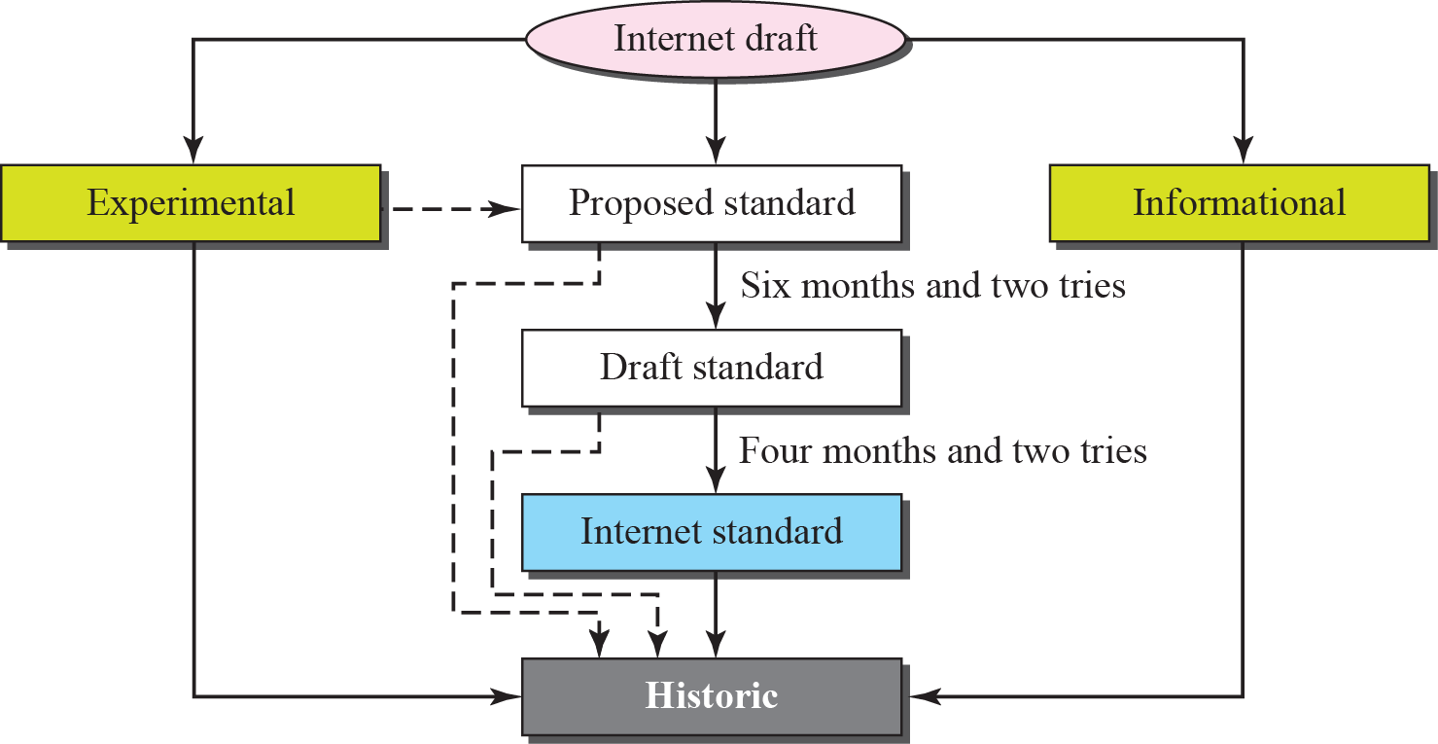
Figure 1-2
Maturity levels of an RFC
The McGraw-Hill Companies, Inc., 2000

Slide 22
Requirement Levels
Required
Must be implemented by all Internet systems
For example, IP and ICMP
Recommended
Not for conformance but for usefulness
For example, FTP and TELNET
Elective
A system can use elective for its own benefit

Slide 23
Requirement Levels (Cont.)
Limited use
Most of the experimental RFCs fall under this category
Used only in limited situations
Not recommended
A historic RFC may fall under this category

Slide 24
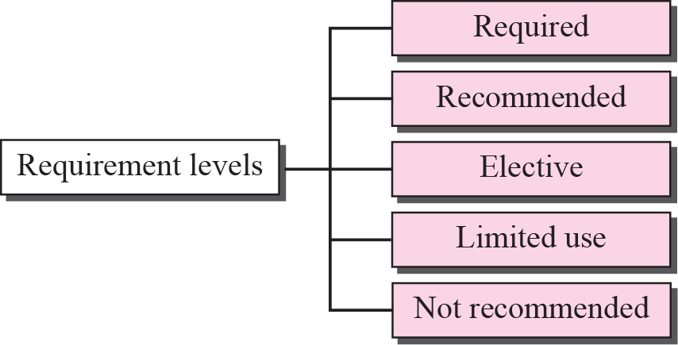
Figure 1-3
Requirement Levels of an RFC
The McGraw-Hill Companies, Inc., 2000

Slide 25

Note
RFCs can be found at http://www.rfc-editor.org.

Slide 26
1.5
INTERNET
ADMINISTRATION

Slide 27
Internet Administration
Internet Society (ISOC)
Internet Architecture Board (IAB)
Internet Engineering Task Force (IETF)
Internet Research Task Force (IRTF)
Internet Assigned Numbers Authority (IANA) and Internet Corporation for Assigned Names and Numbers (ICANN)
Network Information Center (NIC)

